Slide 1
Radiation Testing of RCU2 Components
Insert «Academic unit» on every page: 1 Go to the menu «Insert» 2 Choose: Date and time 3 Write the name of your faculty or department in the field «Footer»
4 Choose «Apply to all"
Master Thesis
Inge Nikolai Torsvik

Slide 2
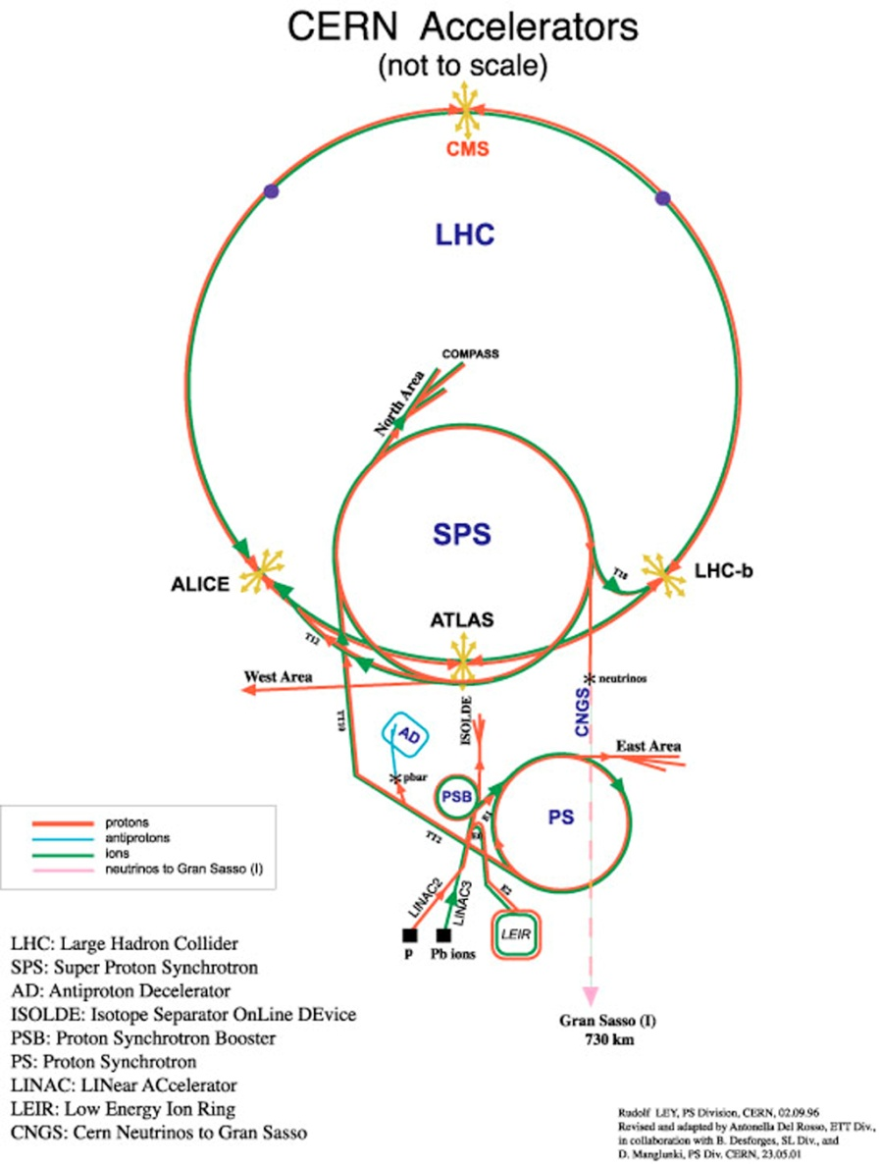
Introduction
At CERN there are being conducted experiments on fundamental structure of the universe.
This is done by us of accelerators, and crashing particles with high energies.
The largest particle-accelerator is LHC, which is able to accelerate protons up to an energy of 4 TeV.
The particles are made to collide at 4 experiment areas in the LHC, and one of these is ALICE.

Slide 3
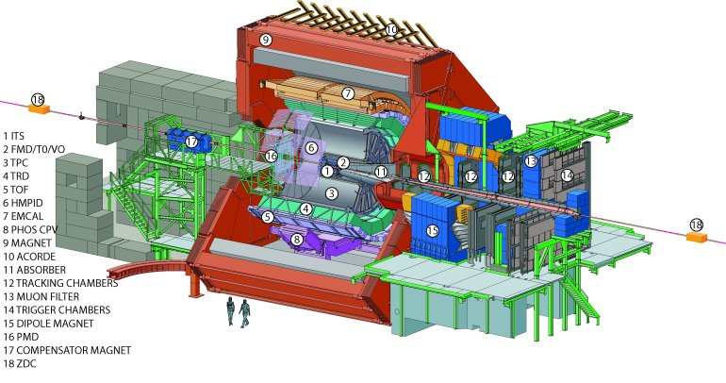
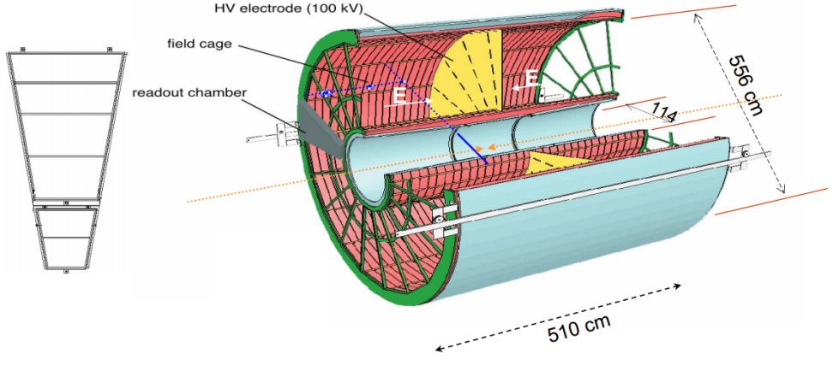
Introduction
ALICE is there to study a state of matter called quark-gluon plasma.
The main tracking detector in ALICE, is the TPC.
The main board in the TPC is RCU, which controls the readout and sends data from the detector to a computer.

Slide 4
Introduction
LHC is currently shut down for maintenance and upgrade to higher energies.
This require more of the RCU, therefore a RCU2 has been made.
The RCU2 will improve the readout rate with 2.6 times, and will be more robust towards radiation induced effects.
A new board introduce new components.
Every new component which is being used in the design of RCU2 has to be tested for radiation, before it can be cleared to be used on the RCU2.
That is what this work consist of: Radiation testing of components used in the RCU2 design.

Slide 5
Introduction
The tested components consist of:
power regulators (TPS51200, MIC69302U)
Bus transceivers (SN74AVCB164245, SN74AVC2T245)
Multiplexer/demultiplexer (QS3VH257)
1 to 4 fan-out buffer (SY89831)
Limiting Amplifiers (ADN2814 and MAX3748)
Current shunt monitor (INA210)
Comparator (TLV3011)
SoC FPGA (SF2 M2S050-FG484 and M2S050ES-FG896)

Slide 6
How to test for radiation tolerance
The radiation effects which have been checked for are:
Accumulative effects – Long term effects due to radiation
TID
Single events effects – Effects from a single particle in a electronic device.
SEU
SET
SEL

Slide 7
The preparation process
To be able to test the different component a PCB was made for each of the components, except for SF2, where a SF2 starter-kit was used.
To be able to send input data and measure output data from the different components USB-DAQ devices from NI was used.
Two PCB was preferable made, this was done for all components except two
Notes:
Ta frem og vis!

Slide 8
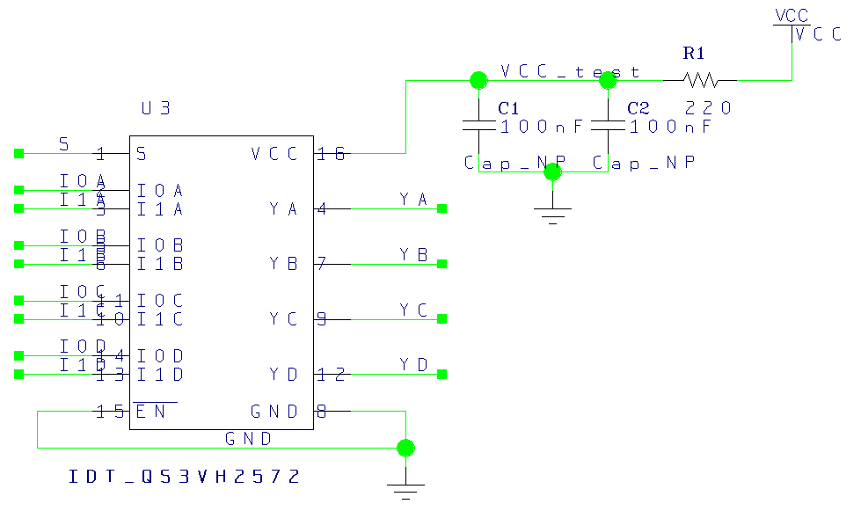
A PCB example

Slide 9
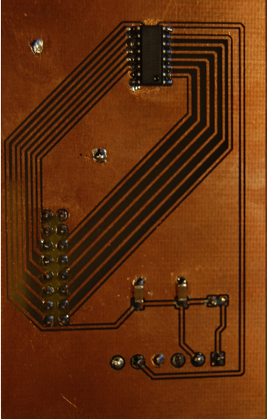
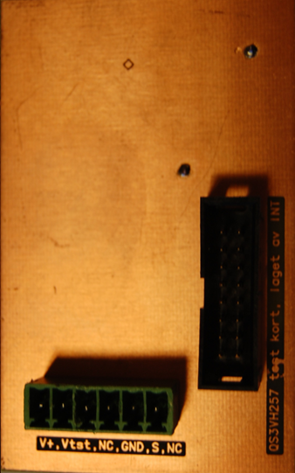

Slide 10
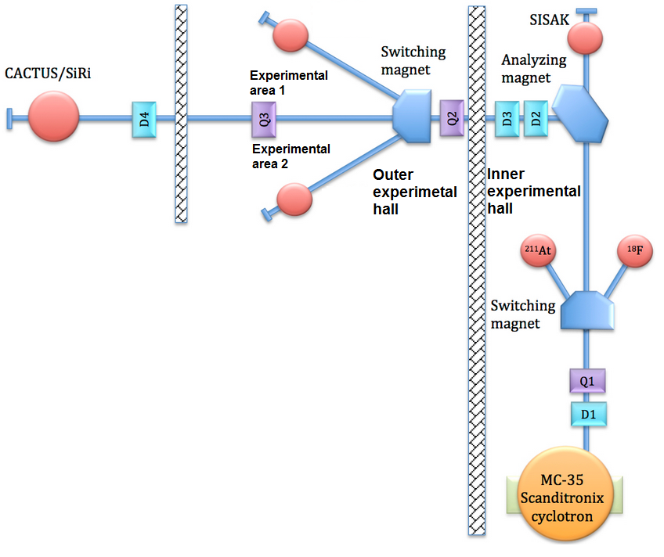
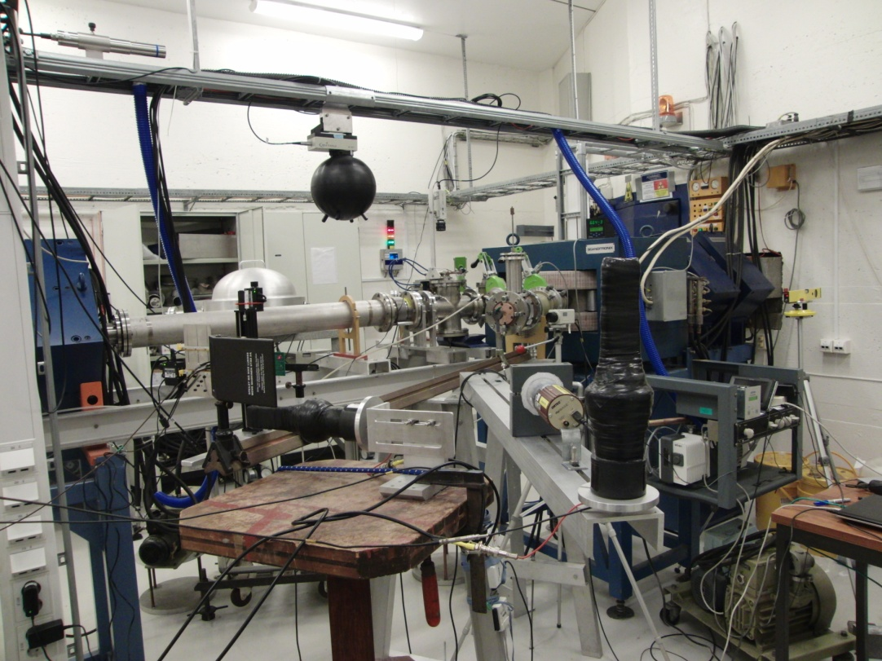
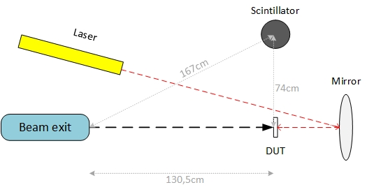
Radiation test setup OCL

Slide 11
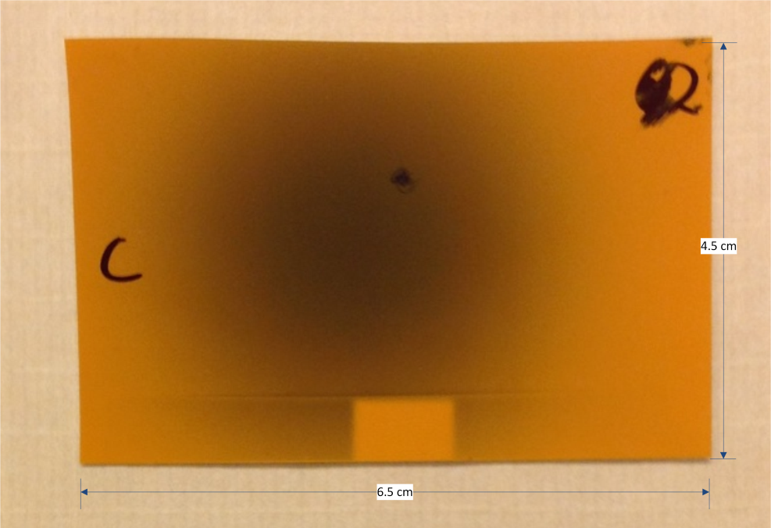
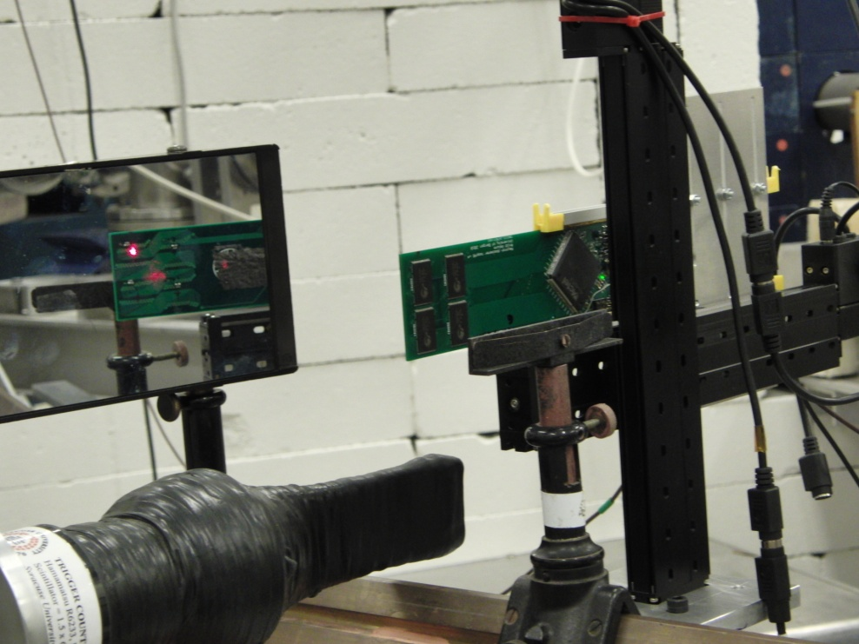
Calibration procedure
Radiation films and SRAM radiation detector was used to find center of beam.
XY-positioning system to move SRAM detector without going into the experiment area.
Relation between SRAM and scintillator was found

Slide 12
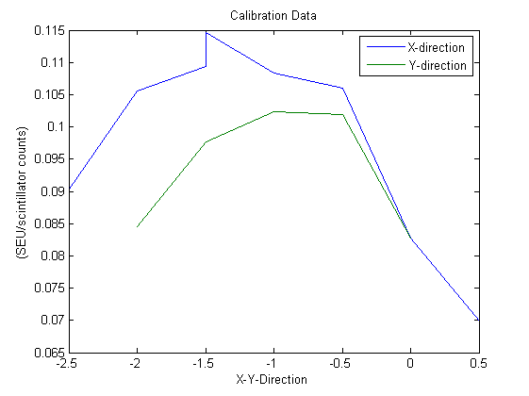

Slide 13
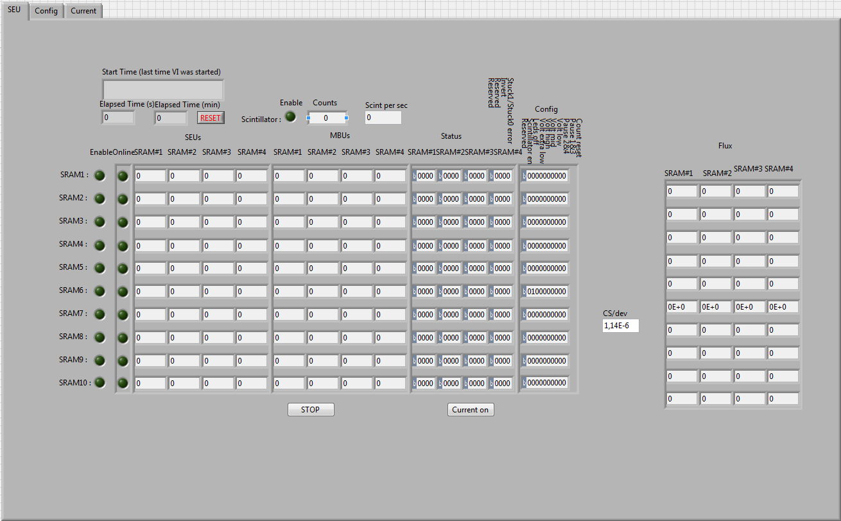
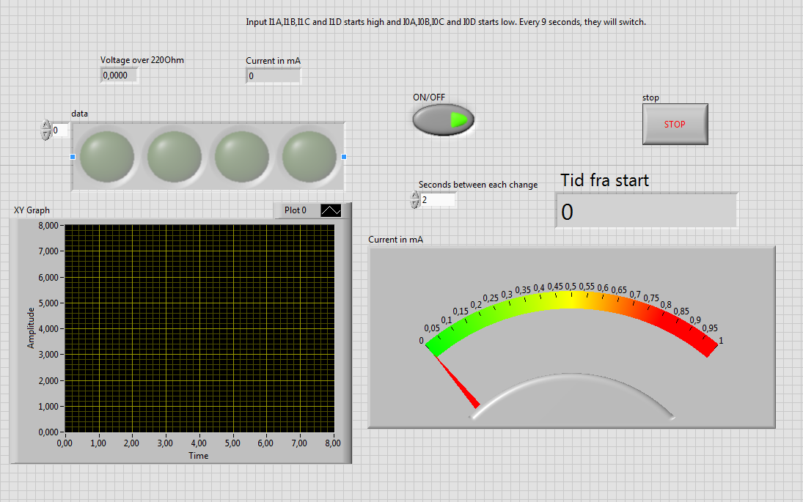
Radiation test procedure
Component mounted on the XY-positioning system.
A computer was placed in the experiment hall with VPN connection.
Three LabVIEW programs were running during a test.
DUT
SRAM radiation detector for scintillator counts
XY-positing system
Both DUT and SRAM programs makes a log file.
Scintillator counts was used to calculate the dose.

Slide 14
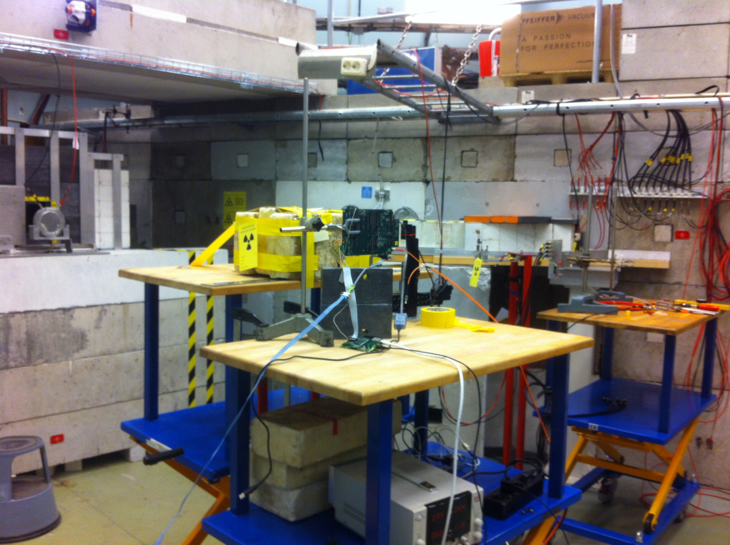
Radiation testing TSL
A defined beam line
Radiation detectors in fixed position.
Didn’t need to think about calibration and measurement of radiation.

Slide 15
Radiation results
PCB boards OCL
SF2 test OCL
Radiation test TSL

Slide 16
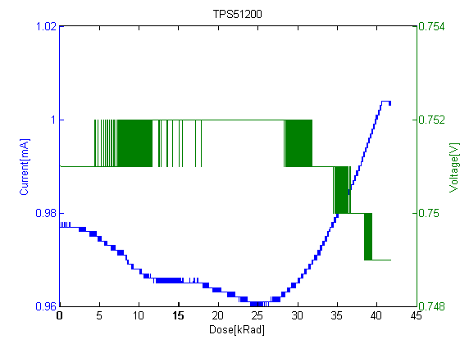
TPS51200 – Power regulator
The focus through the irradiation was:
Power consumption
Output voltage.
Was irradiated 34 min.
Two boards were made, but only one of these was working.
Notes:
PCB got destroyed during transport

Slide 17
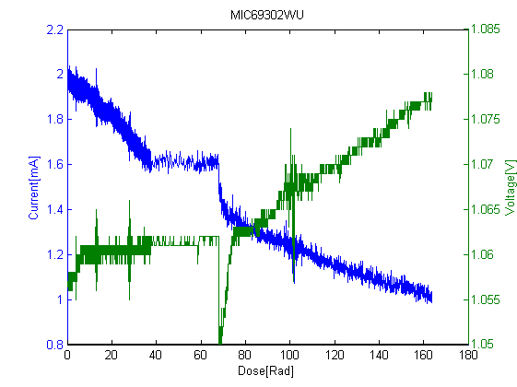
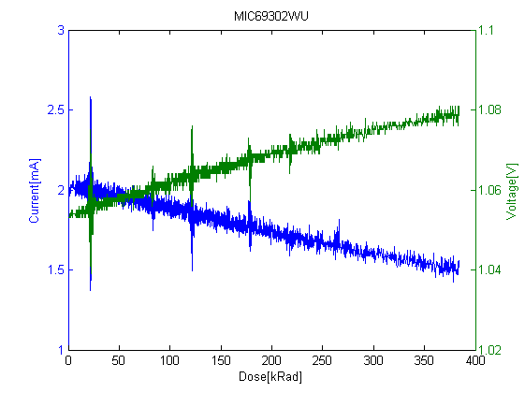
MIC69302U – Power regulator
The focus through the irradiation was:
Power consumption
Output voltage.
Two PCBs.
Current decrease instead of increase.
This could be due to no output load.
The glitches could be due to threshold change in internal transistors.

Slide 18
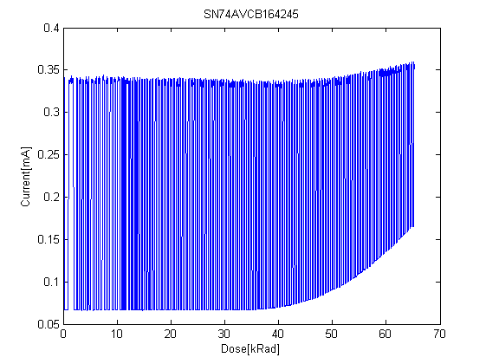
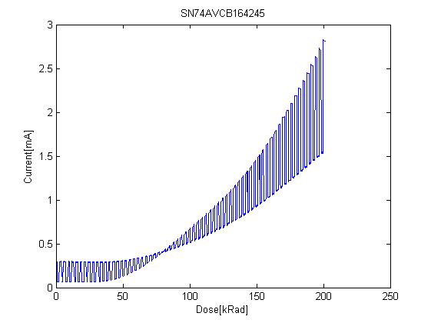
SN74AVCB164245 – Bus transceiver
The focus through the irradiation was:
Outputs are acting accordingly to the input signals
Power consumption
We can see a equal reaction to radiation.
No output errors where detected.
The constant change in current consumption, is due to constant change of the input signal.

Slide 19
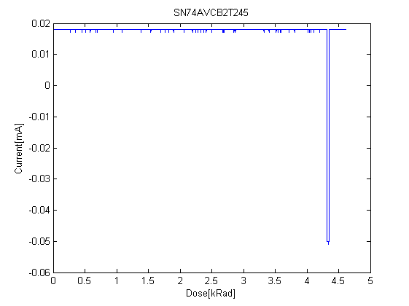
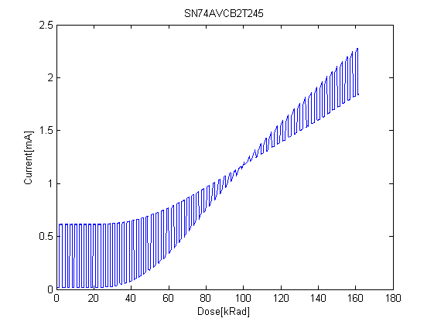
SN74AVC2T245 – Bus Transceiver
The focus through the irradiation was:
Outputs are acting in accordingly to the inputs
Power consumption
Error on the first test board.
Input signal is changing every 4 seconds.

Slide 20
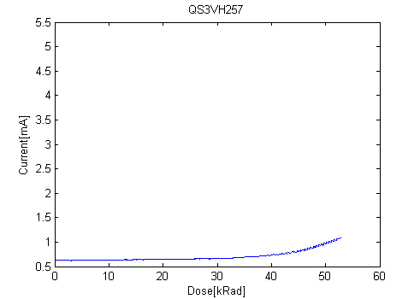
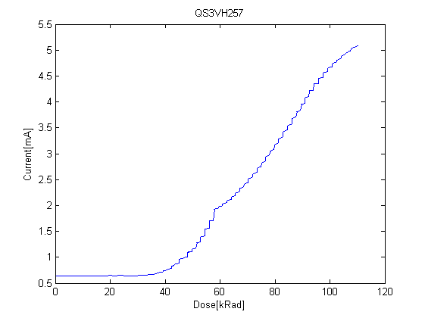
QS3VH257 – Multiplexer/demultiplexer
The focus through the irradiation was:
Outputs are acting in accordingly to the inputs
Power consumption
No errors on output data through the test.
Current vs dose for the two test boards are equal.

Slide 21
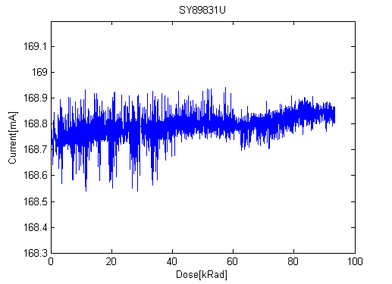
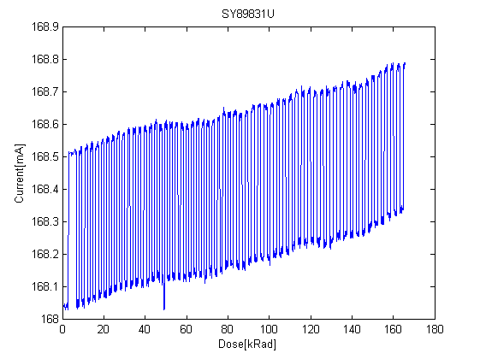
SY89831 – 1 to 4 fan-out buffer
The focus through the irradiation was:
Output signals acting accordingly to the input signal
Power consumption
No output errors were detected.
A little different current characteristic can be detected.
Could be due to over heating when soldering.
Input signal changing every 4 seconds

Slide 22
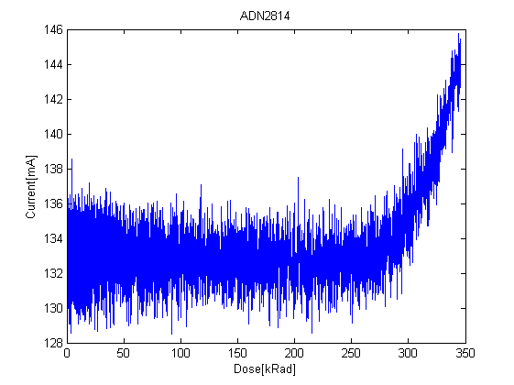
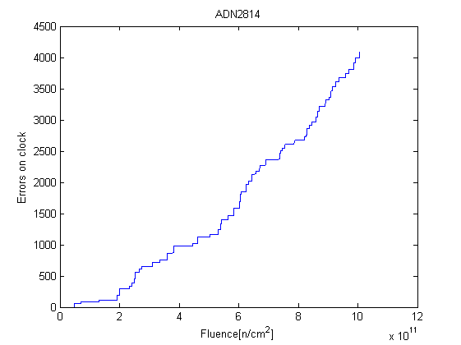
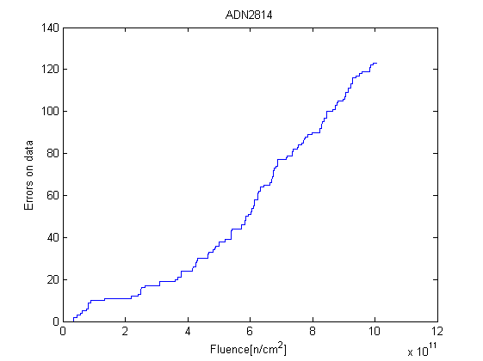
ADN2814 – Limiting amplifier
The focus through the irradiation was:
Output data and clock are acting accordingly to the input signal
Power consumption
During this test we got an data error after 11 kRad for the clock signal, and after a dose of 8 kRad
After these errors we start to get errors more regularly.
Large swing on the current. This could be due to high variation on the input signal.

Slide 23
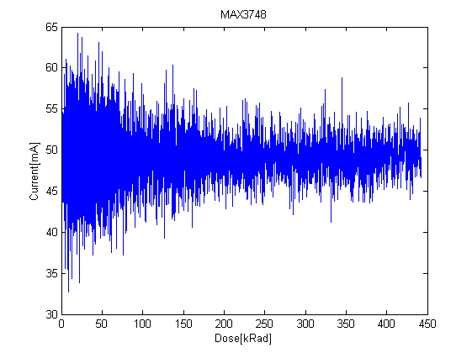
MAX3748 – Limiting amplifier
The focus through the irradiation was:
Output data are acting accordingly to the input signal
Power consumption
No output errors were detected.
Large swing on the current. This could be due to high variation on the input signal.

Slide 24
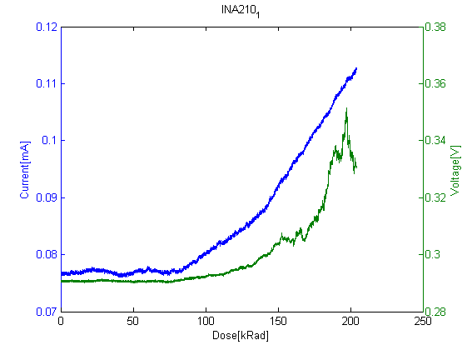
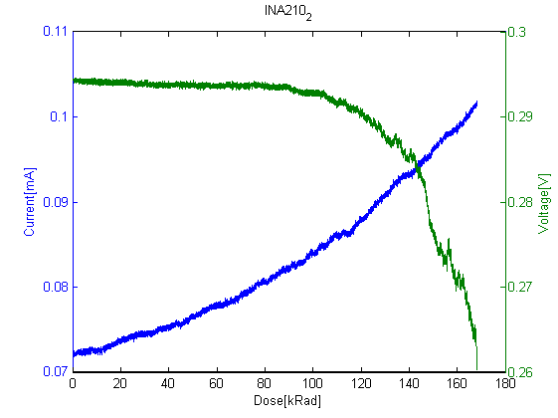
INA210 – Current shunt monitor
The focus through the irradiation were:
Power consumption
Output voltage.
Voltage decrease on one of the tests, and increased on the other.
Could be due to LEDs on the input.
Current vs dose characteristics are close to equal.

Slide 25
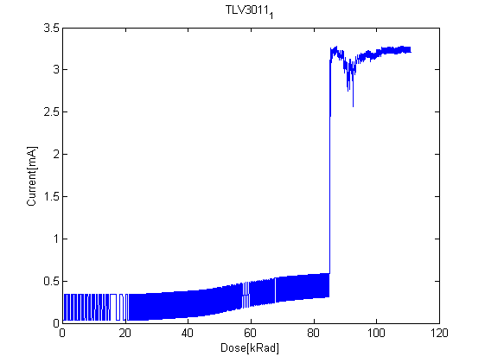
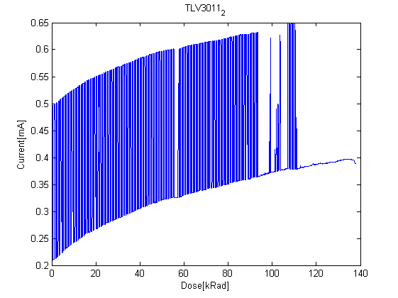
TLV3011 - Comparator
The focus through the irradiation were:
Power consumption
Output voltage.
Both of the tests failed, but after a fairly high dose, 85 and 95 kRad.
Only small increase in current can be detected before the errors.

Slide 26
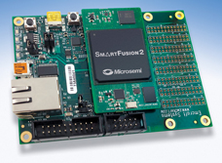
SmartFusion2 radiation test
The focus has been on Single event effects
What were tested through the radiation test of the SF2
Internal SRAM
Logic element
PLL
SEL

Slide 27
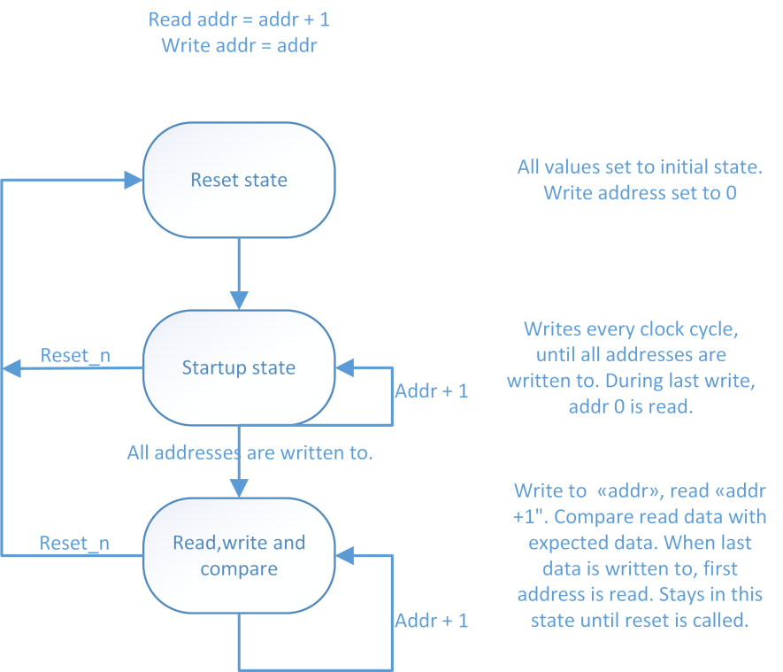
SRAM test
VHDL code for communicating with SRAM memory.
The checking processes is made in a 3 state state-machine.
Outputs SEU counter, and cycle counter.
There are two types of SRAM memory; micro SRAM and large SRAM

Slide 28
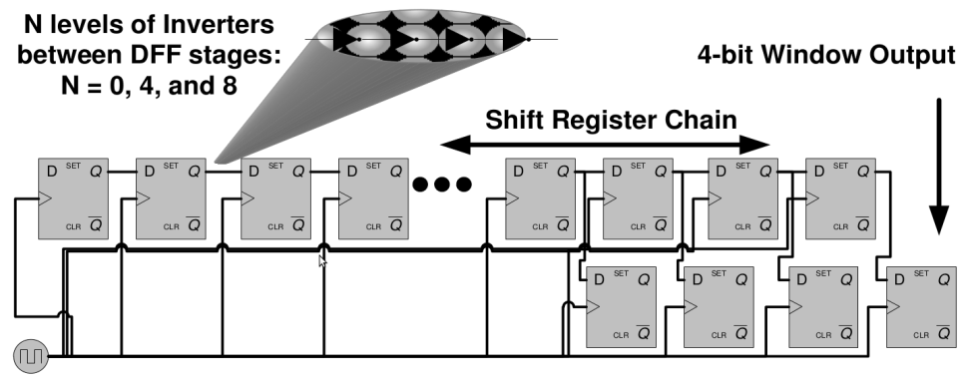
Logic element
A design to check for SEU and SET in logic element.
SET is dependable on frequency, SEU in register are not.
Are able to control the PLL frequency, through a register which is accessible by the microcontroller subsystem.
A known pattern is sent in to the shift-registers, generated in the FPGA.
The output of the register chain is checked by use of another starter-kit.
WSR output.
Notes:
SEU can occur in Flip-flops.
SET can occur on logic tracks and nodes, and may cause SEU.
Should be able to distinguish between SEU and SET by running on different frequencies.

Slide 29
PLL and SEL
PLLs are checked by checking the lock signal of the PLL.
This is done by checking for falling edges.
Latchup is detected by checking power consumption.
Sudden increase in current consumption is most likely SEL

Slide 30
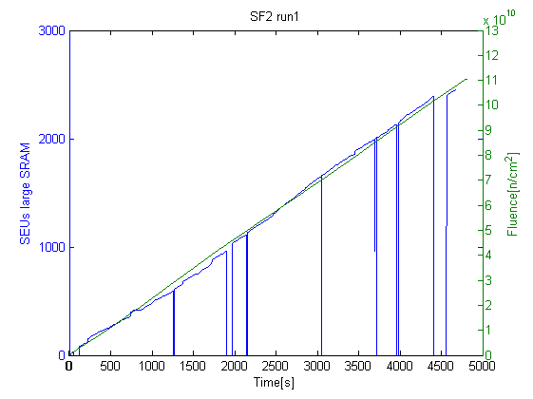
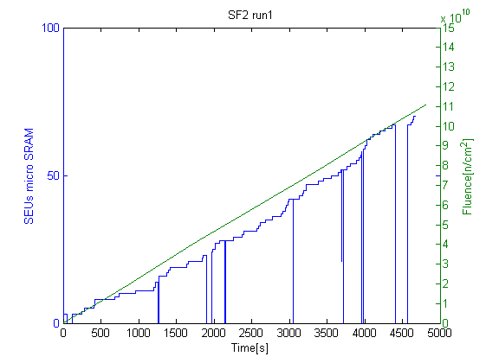
Test results from OCL – SRAM run1
We can see a close to linear increase of SEU compared to fluence.
Problem with Microcontroller subsystem.
Cross section was calculated to be:
3.68 ± 0.64 *10⁻¹⁴ for large SRAM
For micro SRAM 1.03 ± 0.18 *10⁻¹⁴

Slide 31
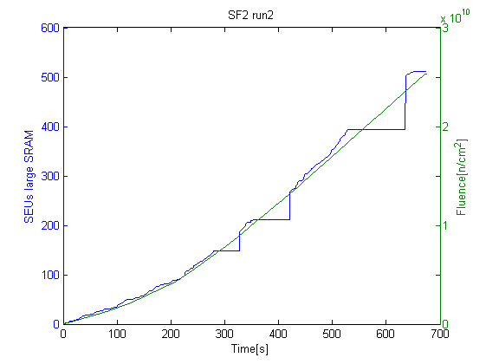
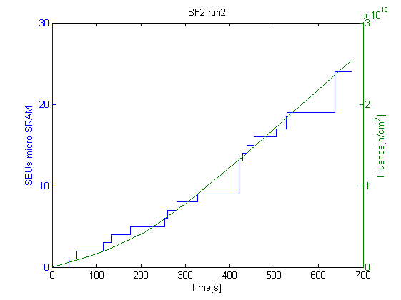
Test results from OCL – SRAM run2
Problem with Microcontroller subsystem.
Cross section was calculated to be:
3.37 ± 0.59 *10⁻¹⁴ for large SRAM
For micro SRAM 1.51 ± 0.27 *10⁻¹⁴
Notes:
Calculated per cell.

Slide 32
Test results from OCL – Logic element (only run2)
Didn’t manage to get the logic element test working on run1
Only run with 40 Mhz
Which means that we are not able to distinguish between SET and SEU.
Cross section per register was calculated to be:
2.74 ± 0.67*10⁻¹⁴
SEU in registers | Exposed time [s] | Fluence [n/cm²]
5 | 620 | 2.28*10¹⁰

Slide 33
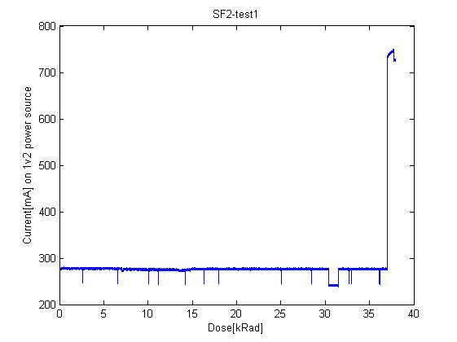
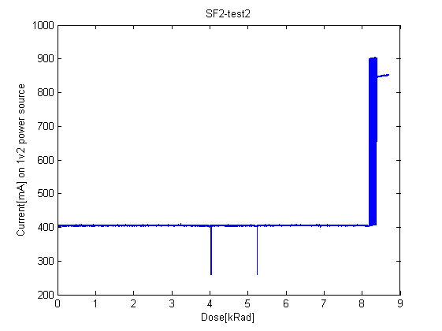
Test results from OCL – SEL
We got two latchups during our two runs
The falls in current are when the microcontroller subsystem stops working.
The current is slightly higher during run2 then run1, this is due to the logic element test is only running on run2.
The current didn’t go back to normal after run2.

Slide 34
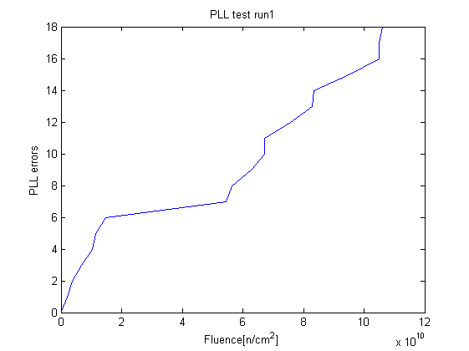
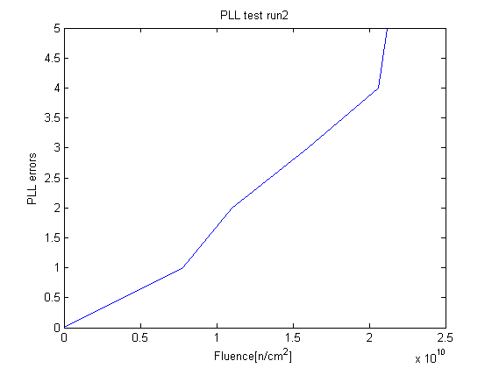
Test results from OCL – PLL
We got regularly PLL lock-loss during the radiation test.
The average cross section was calculated to be:
1.46 ± 0.31*10⁻¹⁰

Slide 35
Radiation tests at TSL – 170 MeV proton beam
The main focus was SF2.
Two prototype of RCU2 was tested and three starter-kits
Detector Data Link2 (SF2 + optical transceiver)
Timing, trigger and Control (SF2 + Optical receiver)

Slide 36
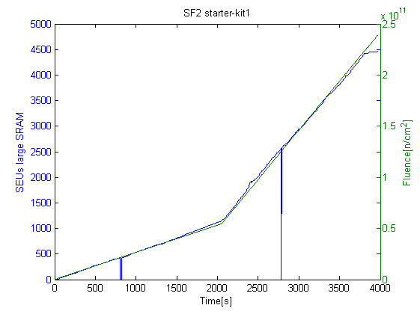
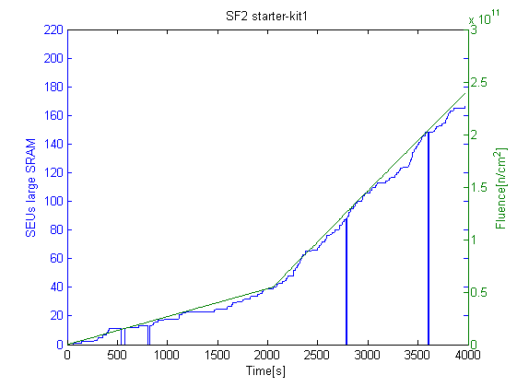
Radiation tests at TSL – SRAM test 1
Cross section was calculated to be:
LSRAM = 3.64 ± 0.38 *10⁻¹⁴
µSRAM = 1.27 ± 0.13 *10⁻¹⁴
Still had problems with microcontroller subsystem.

Slide 37
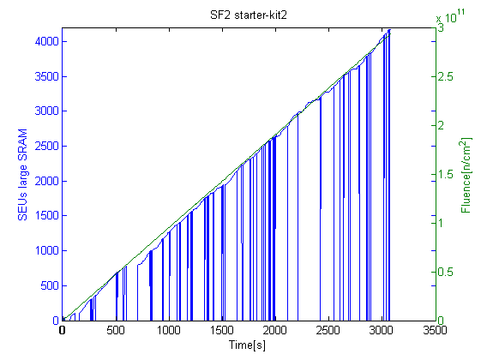
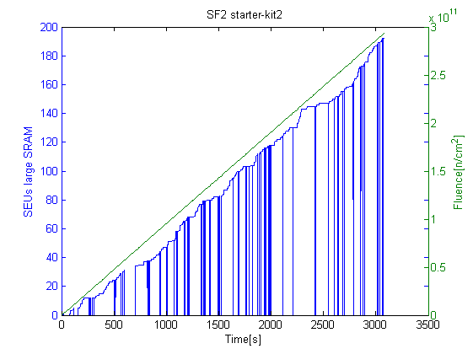
Radiation tests at TSL – SRAM test 2
Cross section was calculated to be:
LSRAM = 3.37 ± 0.35 *10⁻¹⁴
µSRAM = 1.51 ± 0.16 *10⁻¹⁴
Still had problems with microcontroller subsystem.

Slide 38
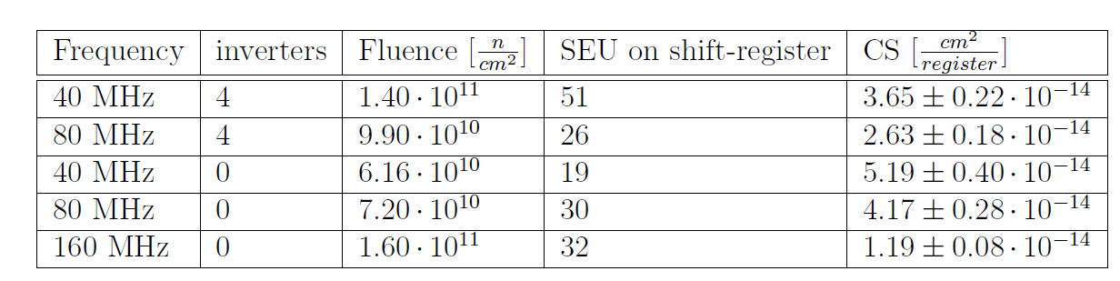
Radiation tests at TSL – Logic element
Ran at 40, 80 and 160 Mhz.
Didn’t see a pattern with increasing detected SEU with higher frequencies. Could be due to not sufficient data
Mean Time Between Failure (MTBF) is in the area of 9 to 38 min, considering run2 in the LHC, with 216 RCU2 and if all registers are used.
That means that redundancy or error fixing code should be used when possible.

Slide 39

Radiation tests at TSL – PLL
During the test three PLL was monitored.
A average cross section was calculated to be:
2.39±0.10 * 10⁻¹⁰
This means that if only 1 PLL is used, we will see PLL lock-loss every 107 min when all the RCU2 are mounted in the TPC.

Slide 40
Radiation tests at TSL – SEL
WE got regularly SEL during the test.
But we also had a problem, with drop in current.
When this happened the 1.2 V dropped to around 0.85 mV
This happened well as often as the latches.
Cross section will therefore not give us a correct

Slide 41
Programming limit test
A test to see how high up in dose of radiation the SF2 tolerates, before it cannot be programmed anymore.
We tried programming after 1.20 kRad, 2.54 kRad and 3.80 kRad.
After 3.80 kRad the programming failed.

Slide 42
Other tests at TSL
Detector data link.
Timing, trigger and control.

Slide 43
Summary and Conclution

